Slide 1


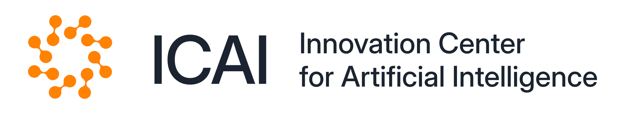
MICCAI 2025 SSL3D / FOMO60k Challenge
Puru Vaish (Mei) The Latent Campus

Slide 2


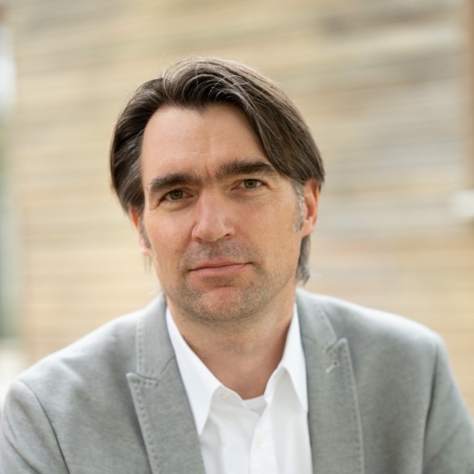
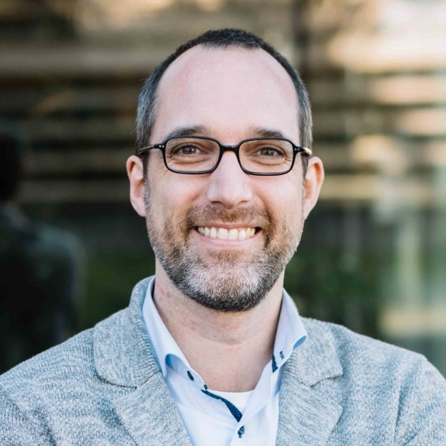
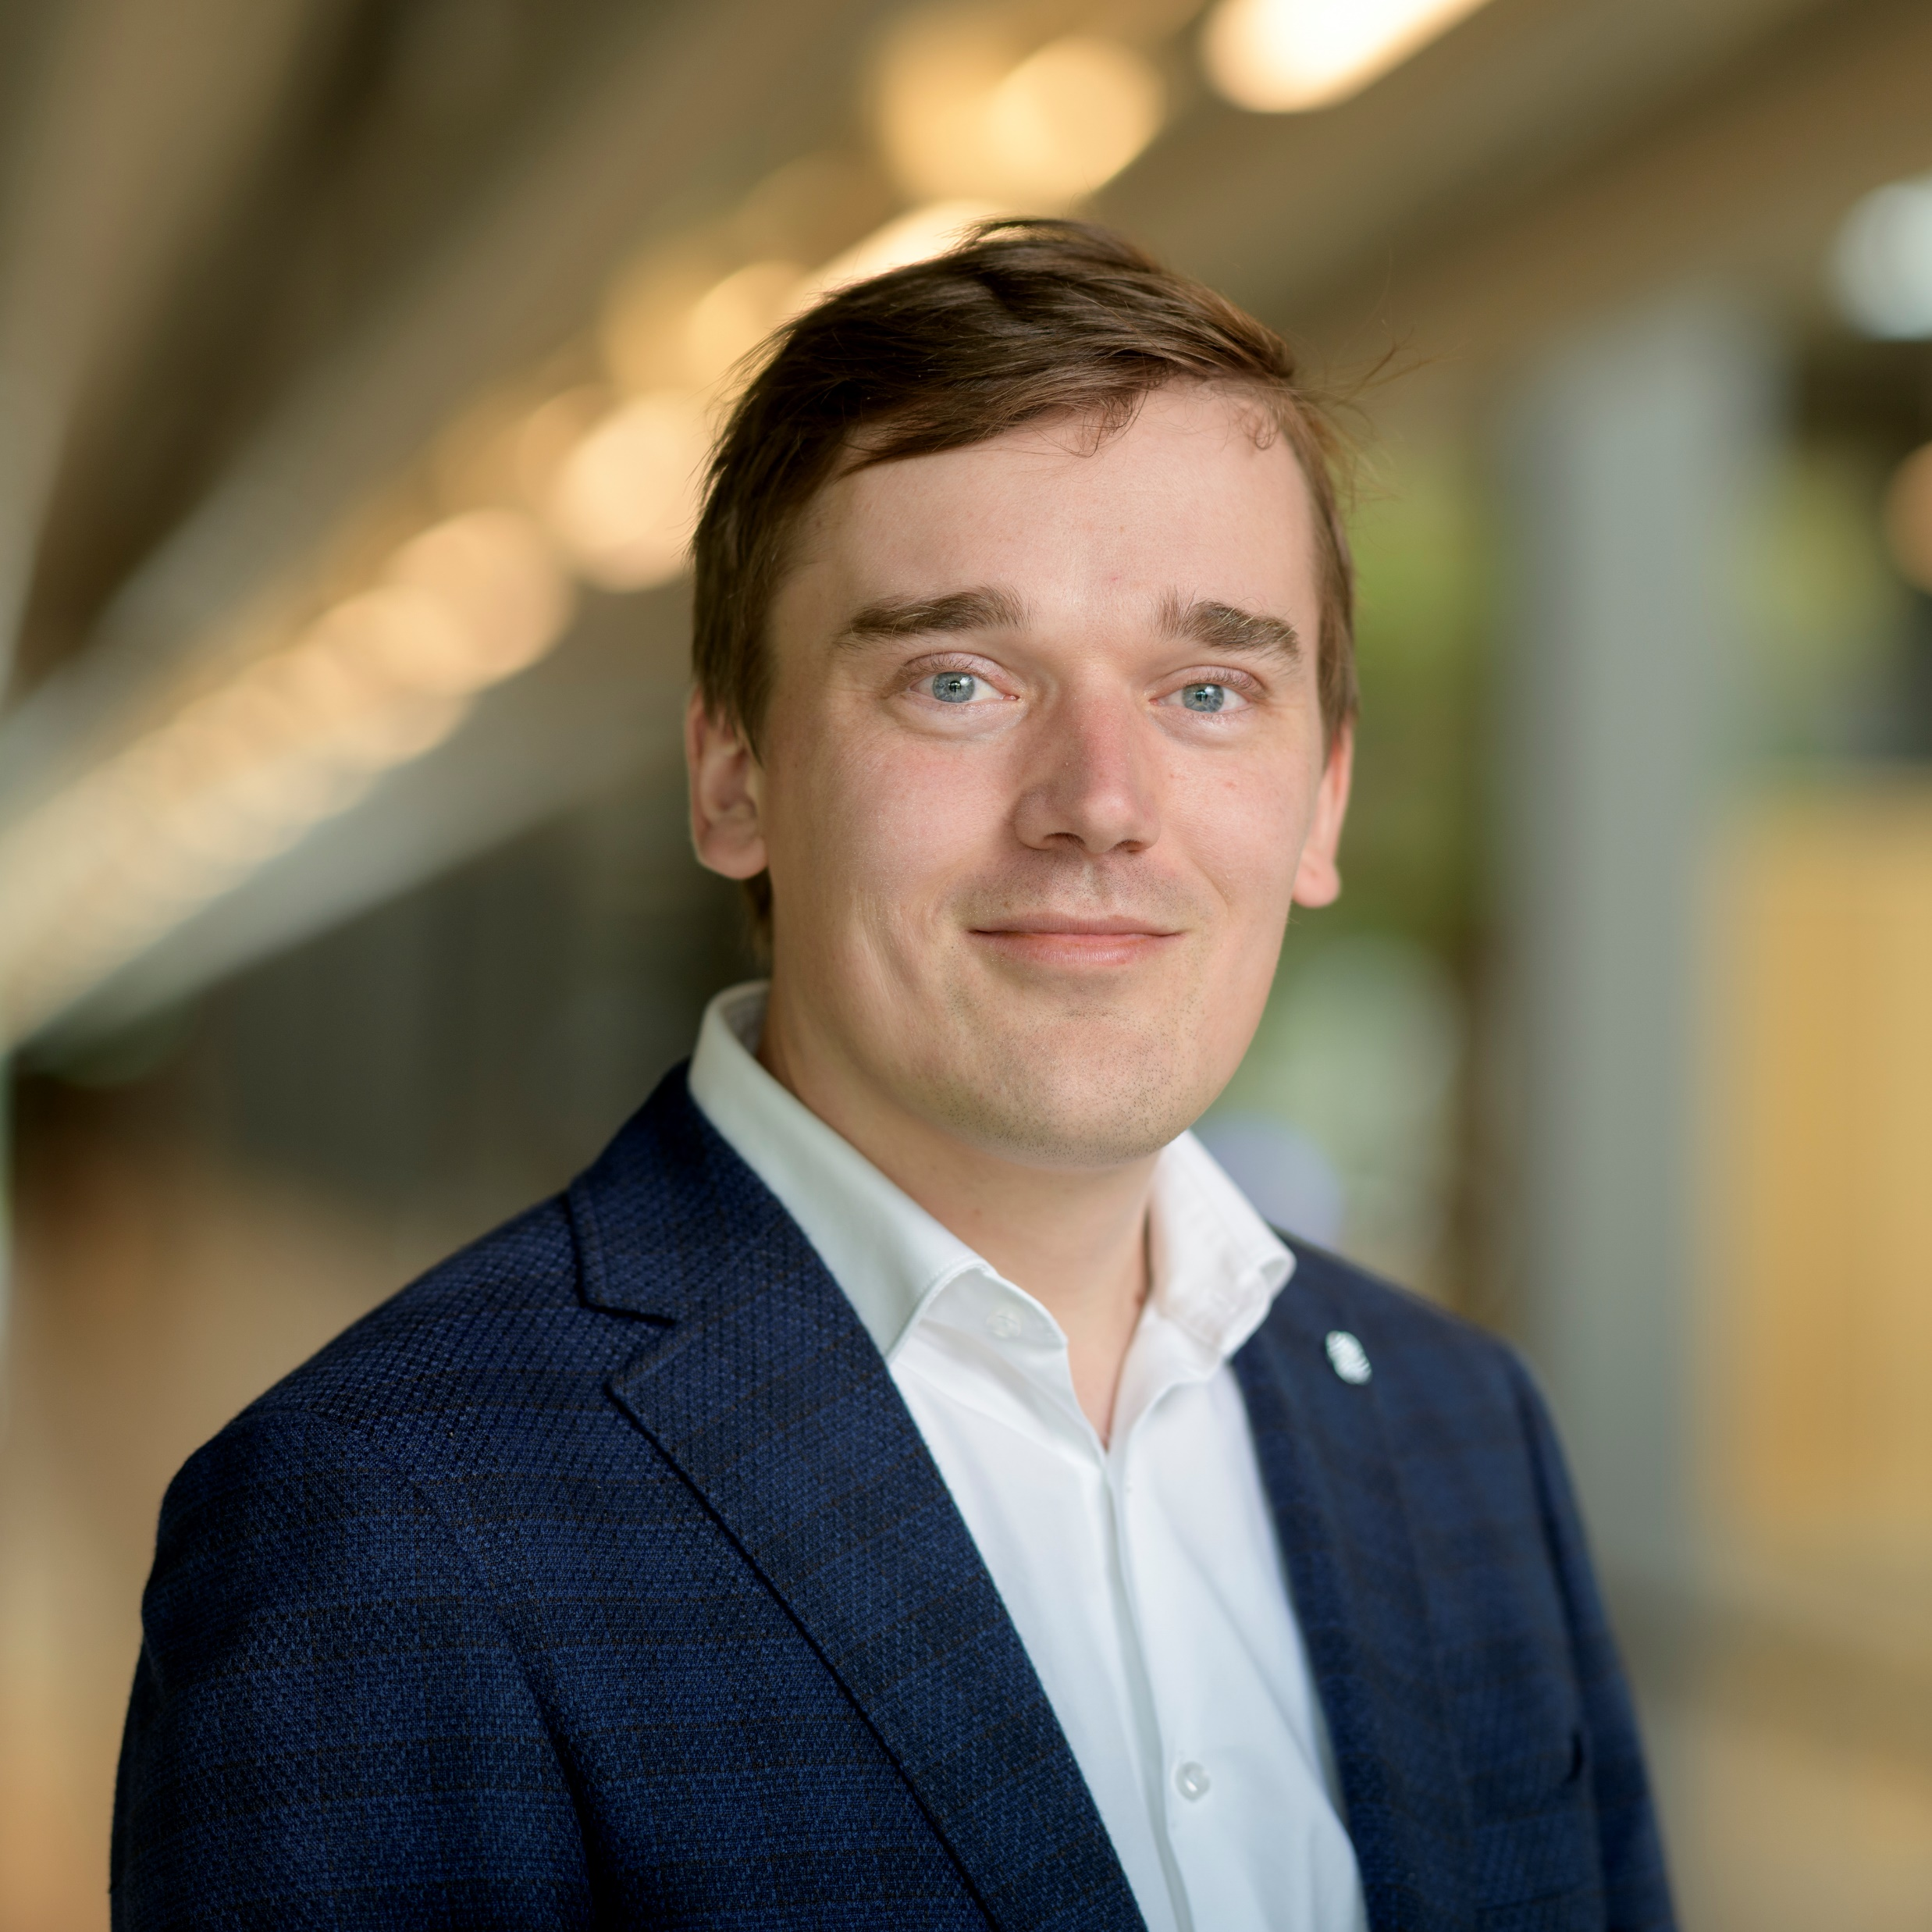
The Brain Stem of TheLatentCampus
Puru Vaish (Mei)¹
Felix Meister²
Tobias Heimann²
Christoph Brune¹
Jelmer Wolterink¹
Department of Applied Mathematics, Technical Medical Centre, University of Twente
Digital Technology and Innovation, Siemens Healthineers, Erlangen, Germany

Slide 3
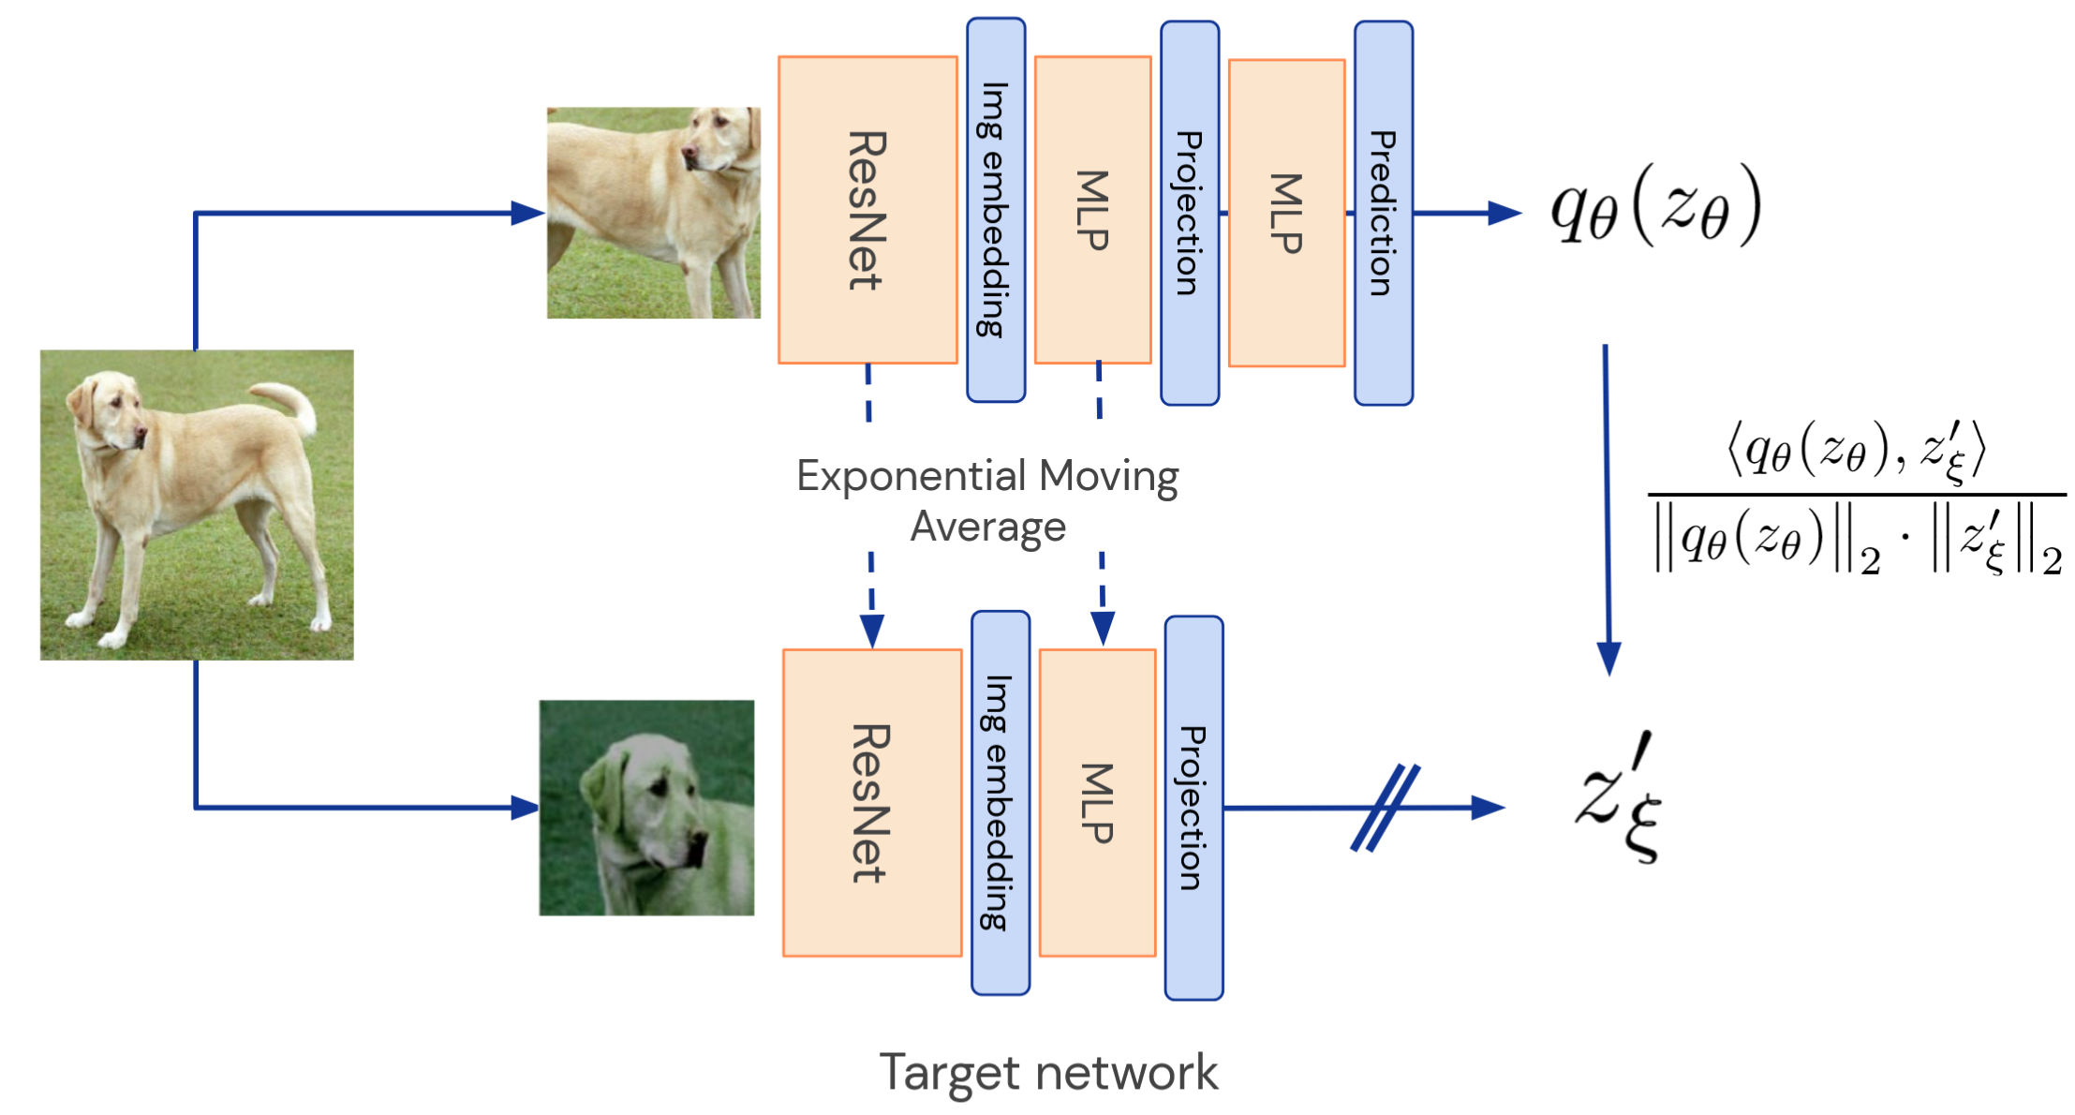
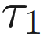
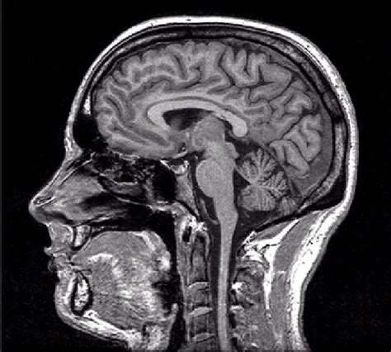
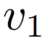
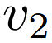
State of Self-Supervised Learning
He, Kaiming, et al. "Masked Autoencoders Are Scalable Vision Learners." arXiv, 11 Nov. 2021, doi:10.48550/arXiv.2111.06377. Huang, Zhicheng, et al. "Contrastive Masked Autoencoders are Stronger Vision Learners." arXiv, 27 July 2022, doi:10.1109/TPAMI.2023.3336525.

Slide 4

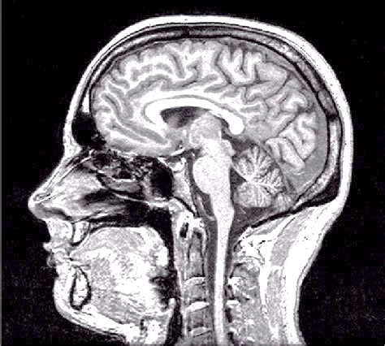
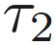
State of Self-Supervised Learning
Chen, Ting, et al. "A Simple Framework for Contrastive Learning of Visual Representations.“ arXiv, 13 Feb. 2020, doi:10.48550/arXiv.2002.05709. Grill, Jean-Bastien, et al. "Bootstrap your own latent" arXiv, 13 June 2020, doi:10.48550/arXiv.2006.07733.

Slide 5
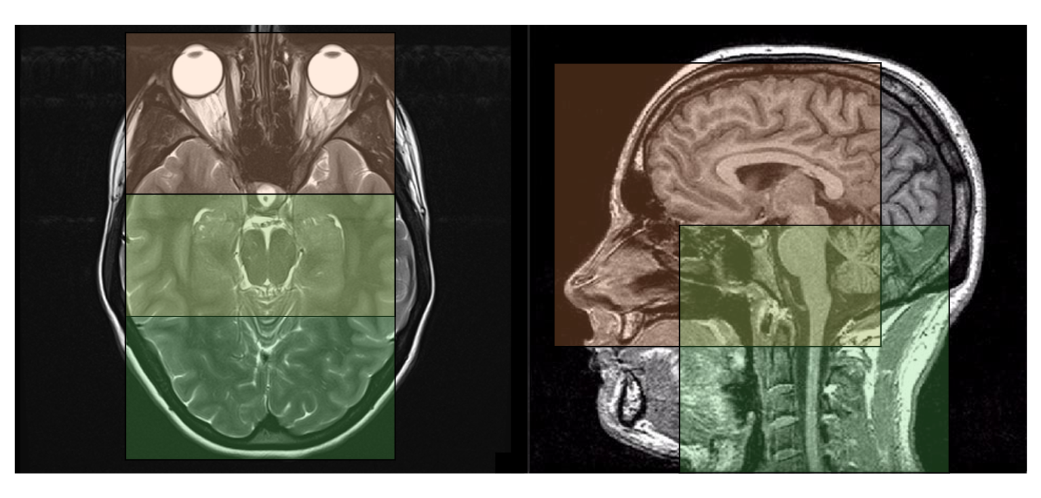
There is an Issue
Loosely correlated regions are enforced to be “similar”
Poor representation learning and generalisation
Need for alignment of features.
Frontal Lobes
Eyes, Jaw, Nose
Hindbrain
Brain Stem
Notes:
While two crops have an overlapping region between them,
the two crops can be argued to represent completely different se-
mantic information. However, self-supervised learning methods
still treat them as positive pairs, forcing the model to align unre-
lated features, which can degrade representation quality for down-
stream tasks where ability to differentiate is important.

Slide 6
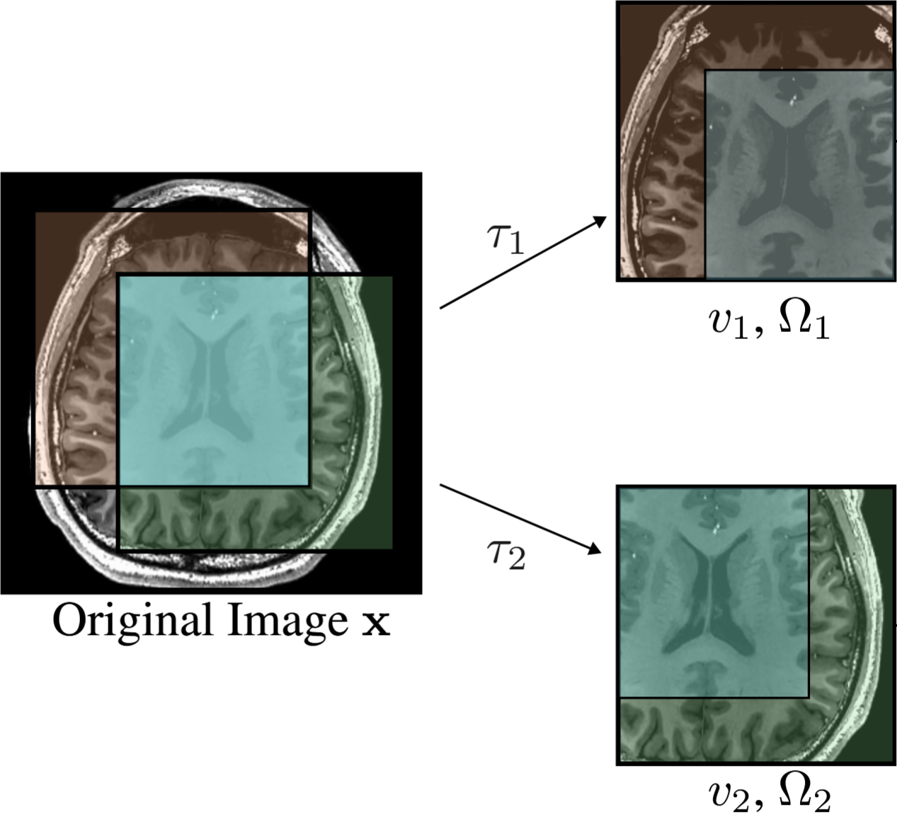
Consistent View
Given the original image get two volumes with an overlapping region.
Keep track of where the overlap is.

Slide 7
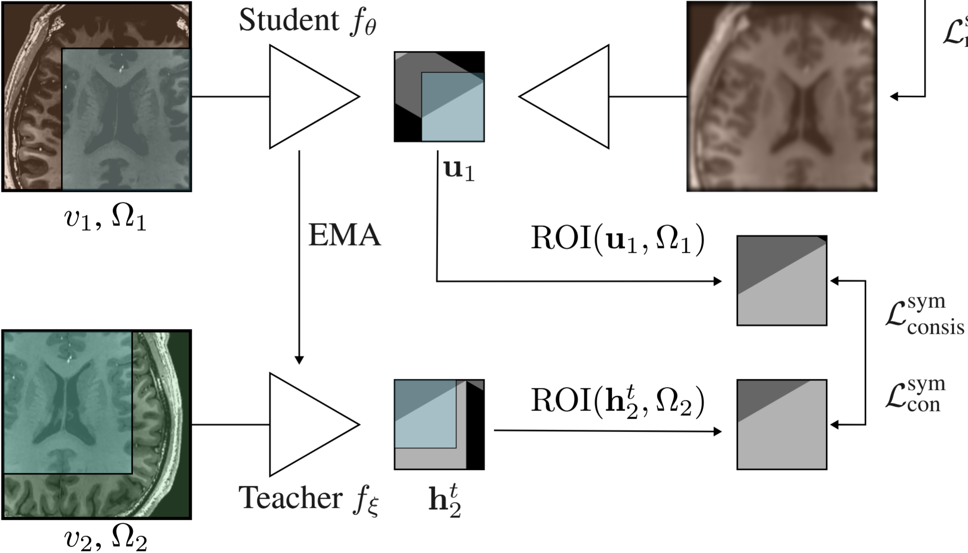
Alignment
Extract the features and using the saved bounding boxes to align the features.

Slide 8
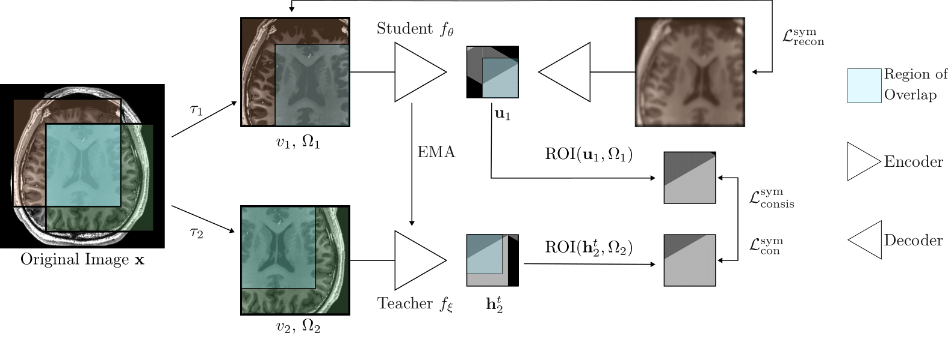
Consistent View + Alignment = CVA
He, Kaiming, et al. "Masked Autoencoders Are Scalable Vision Learners." arXiv, 11 Nov. 2021, doi:10.48550/arXiv.2111.06377.
Chen, Xinlei and Kaiming He. "Exploring Simple Siamese Representation Learning." arXiv, 20 Nov. 2020, doi:10.48550/arXiv.2011.10566.

Slide 9
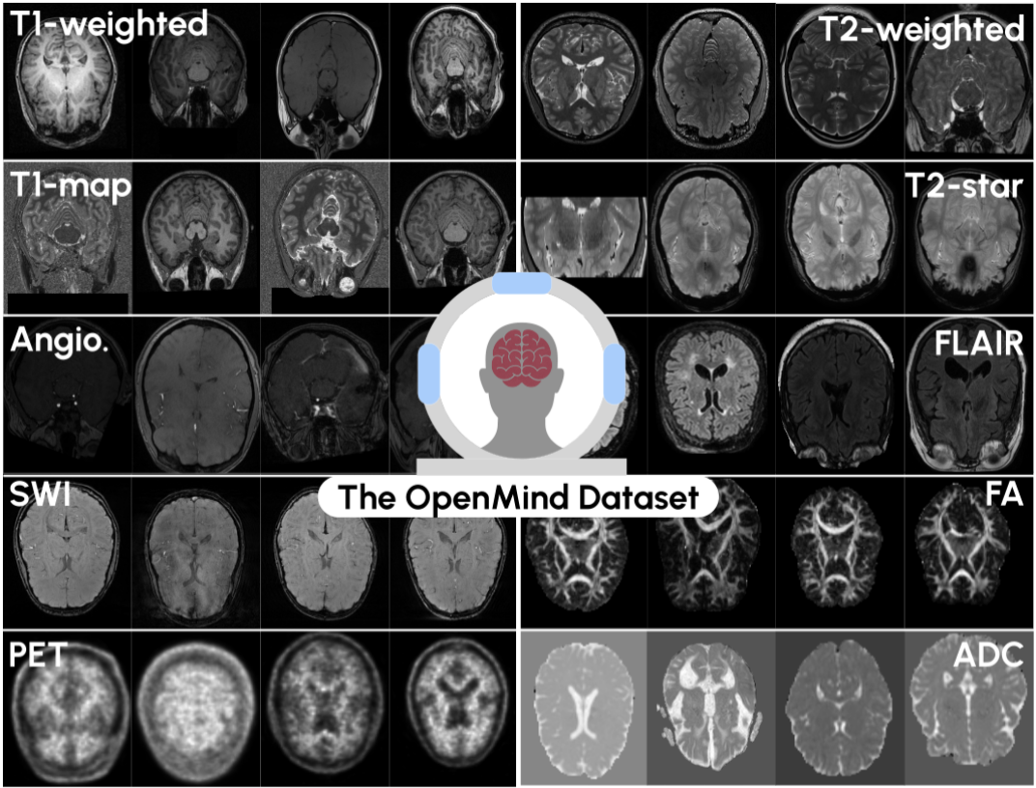
OpenMind Dataset
Dataset Overview
Large publicly available head & neck MRI dataset (via OpenNeuro)
Aggregates 800+ datasets, released under CC0/PDDL licenses
Standardized and cleaned: 114,570 3D volumes from 34,191 patients
Covers 23 modalities MRI sequences (T1w, FLAIR, T2w, MD, FA, and more)
Publicly hosted on Hugging Face

Slide 10
Two Stage Training
Stage | Architecture | Details | Duration Single L40
Pretraining MAE Huber Loss | ResEnc-L | 1000 epochs | ~7 days
 | Primus-M |  | ~9 days
Post-pretraining - Respective losses | ResEnc-L | 250 epochs | ~1.5 days
 | Primus-M | 150 epochs | ~2 days
Pros: 37 GPU days vs 112 GPU days over 14 ablations.
Cons: Bias towards MAE representations.
Wald, Tassilo, et al. "An OpenMind for 3D medical vision self-supervised learning." arXiv, 22 Dec. 2024, doi:10.48550/arXiv.2412.17041.

Slide 11

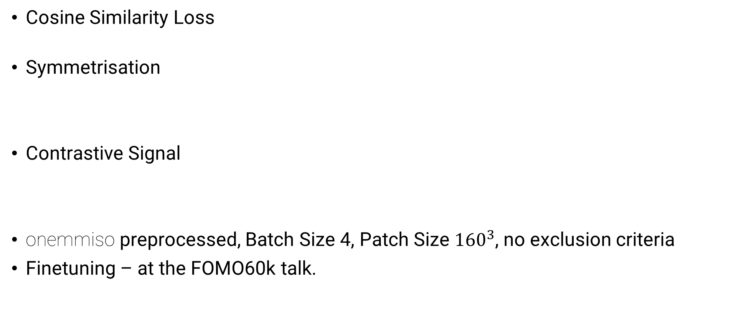
Technical Details
Cosine Similarity Loss
Symmetrisation
Contrastive Signal
onemmiso preprocessed, Batch Size 4, Patch Size ${160}^{3}$, no exclusion criteria
Finetuning – at the FOMO60k talk.
Caron, Mathilde, et al. "Unsupervised Learning of Visual Features by Contrasting Cluster Assignments." arXiv, 17 June 2020, doi:10.48550/arXiv.2006.09882.
Huang, Zhicheng, et al. "Contrastive Masked Autoencoders are Stronger Vision Learners." arXiv, 27 July 2022, doi:10.1109/TPAMI.2023.3336525. He, Kaiming, et al. "Masked Autoencoders Are Scalable Vision Learners." arXiv, 11 Nov. 2021, doi:10.48550/arXiv.2111.06377.
Chen, Xinlei and Kaiming He. "Exploring Simple Siamese Representation Learning." arXiv, 20 Nov. 2020, doi:10.48550/arXiv.2011.10566.

Slide 12
Consistent View + Alignment = CVA
He, Kaiming, et al. "Masked Autoencoders Are Scalable Vision Learners." arXiv, 11 Nov. 2021, doi:10.48550/arXiv.2111.06377.
Chen, Xinlei and Kaiming He. "Exploring Simple Siamese Representation Learning." arXiv, 20 Nov. 2020, doi:10.48550/arXiv.2011.10566.

Slide 13
Pre-Challenge Ablation Ladder
4 Segmentation Datasets
Ischemic Stroke Lesions
Yale Brain Metastasis
BraTS: Post-Glioblastoma
Medical Segmentation Decathlon: Brain Tumour Segmentation
1 Classification Dataset
ABIDE 2
Rankings should be interpreted with care
Maier-Hein, Lena, et al. "Why rankings of biomedical image analysis competitions should be interpreted with care." Nat. Commun. doi:10.1038/s41467-018-07619-7.

Slide 14
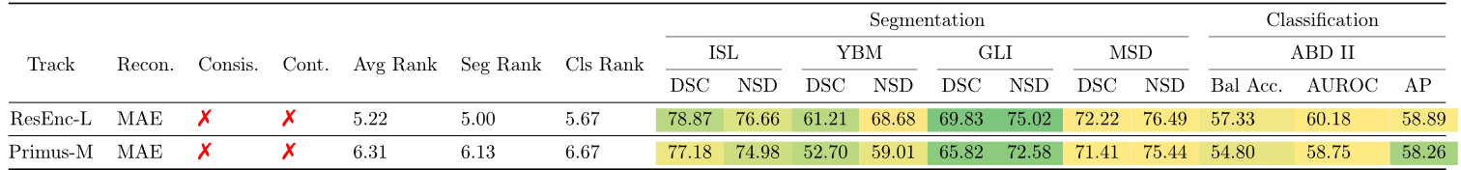
Ablation Ladder - MAE

Slide 15
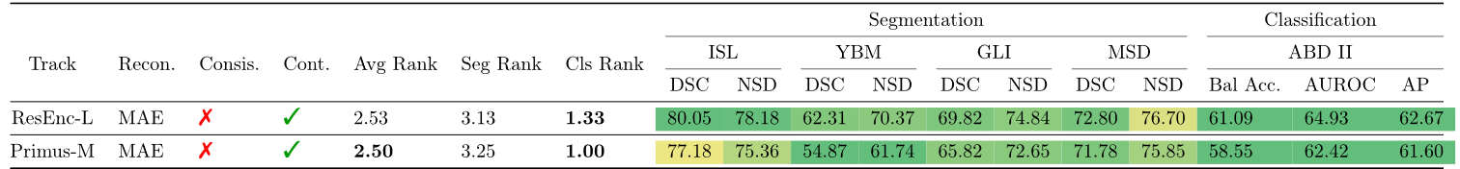
Ablation Ladder – Contrastive MAE

Slide 16
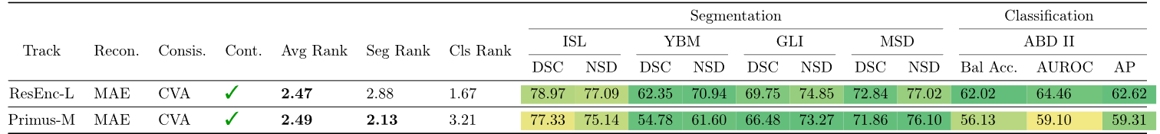
Ablation Ladder – CVA w/ Contrastive Signal

Slide 17
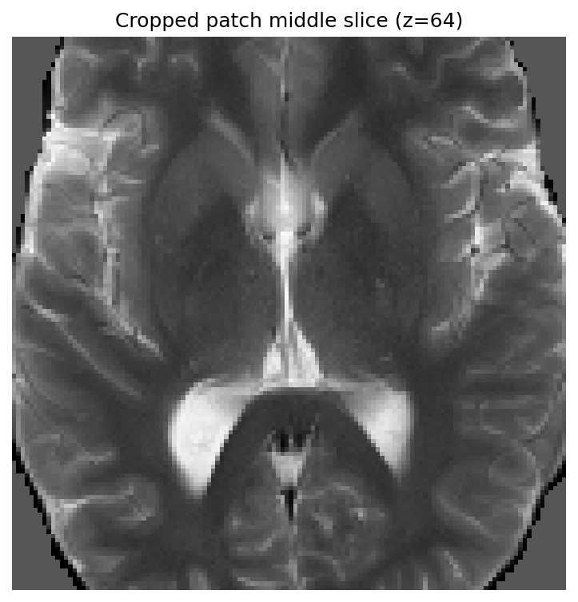
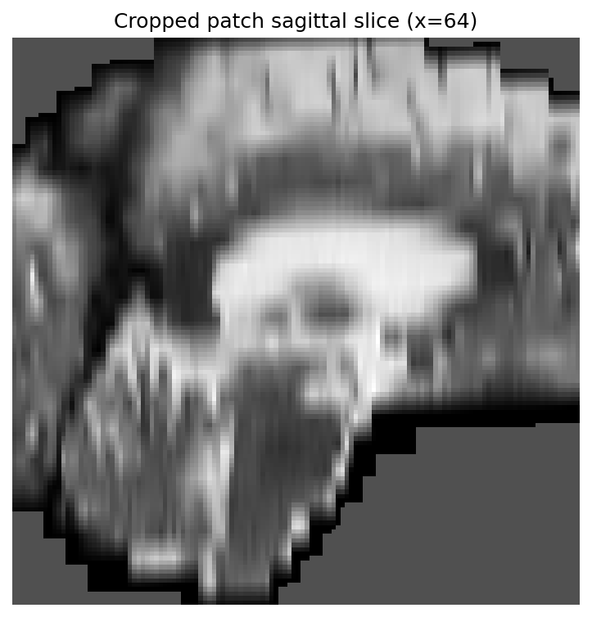
Quality of Representation

Slide 18
k-Means Clustering

Slide 19
k-Means Clustering

Slide 20
k-Means Clustering

Slide 21
k-Means Clustering

Slide 22
FOMO60K - Finetuning
Classification
Baseline Codebase provided by the Challenge
128 patch size
8 batch accumulation
Brain Age Regression
Baseline Codebase provided by the Challenge
128 patch size
16 batch accumulation
Segmentation
50 epochs, 100 iterations of nnUNet training from pretrained checkpoint.
5 fold cross validation.
Best model sent for final testing.

Slide 23


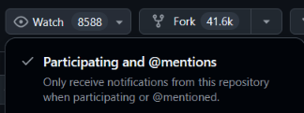

Flexible Framework makes the World Work
Even more ablations!
Different types of consistency:
Effect of contrastive signal
Contrastive
Gram Matrix
Ranking Interpretations
Code Publicly Available
Extension of nnssl and compatible with nnunet_adaption
Pretrained Weights
Soon on Zenodo (watch on GitHub for updates)

Slide 24
Being Consistent Helps! Alignment Helps!
These models are our babies:
We need to be consistent in our loss terms.
We need to align them to our domain.
We need to be patient and let them learn.

Slide 25
State of Self-Supervised Learning
Chen, Ting, et al. "A Simple Framework for Contrastive Learning of Visual Representations." arXiv, 13 Feb. 2020, doi:10.48550/arXiv.2002.05709.

Slide 26
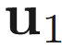
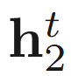
State of Self-Supervised Learning
Student Branch
Teacher Branch
Grill, Jean-Bastien, et al. "Bootstrap your own latent" arXiv, 13 June 2020, doi:10.48550/arXiv.2006.07733.

Slide 27
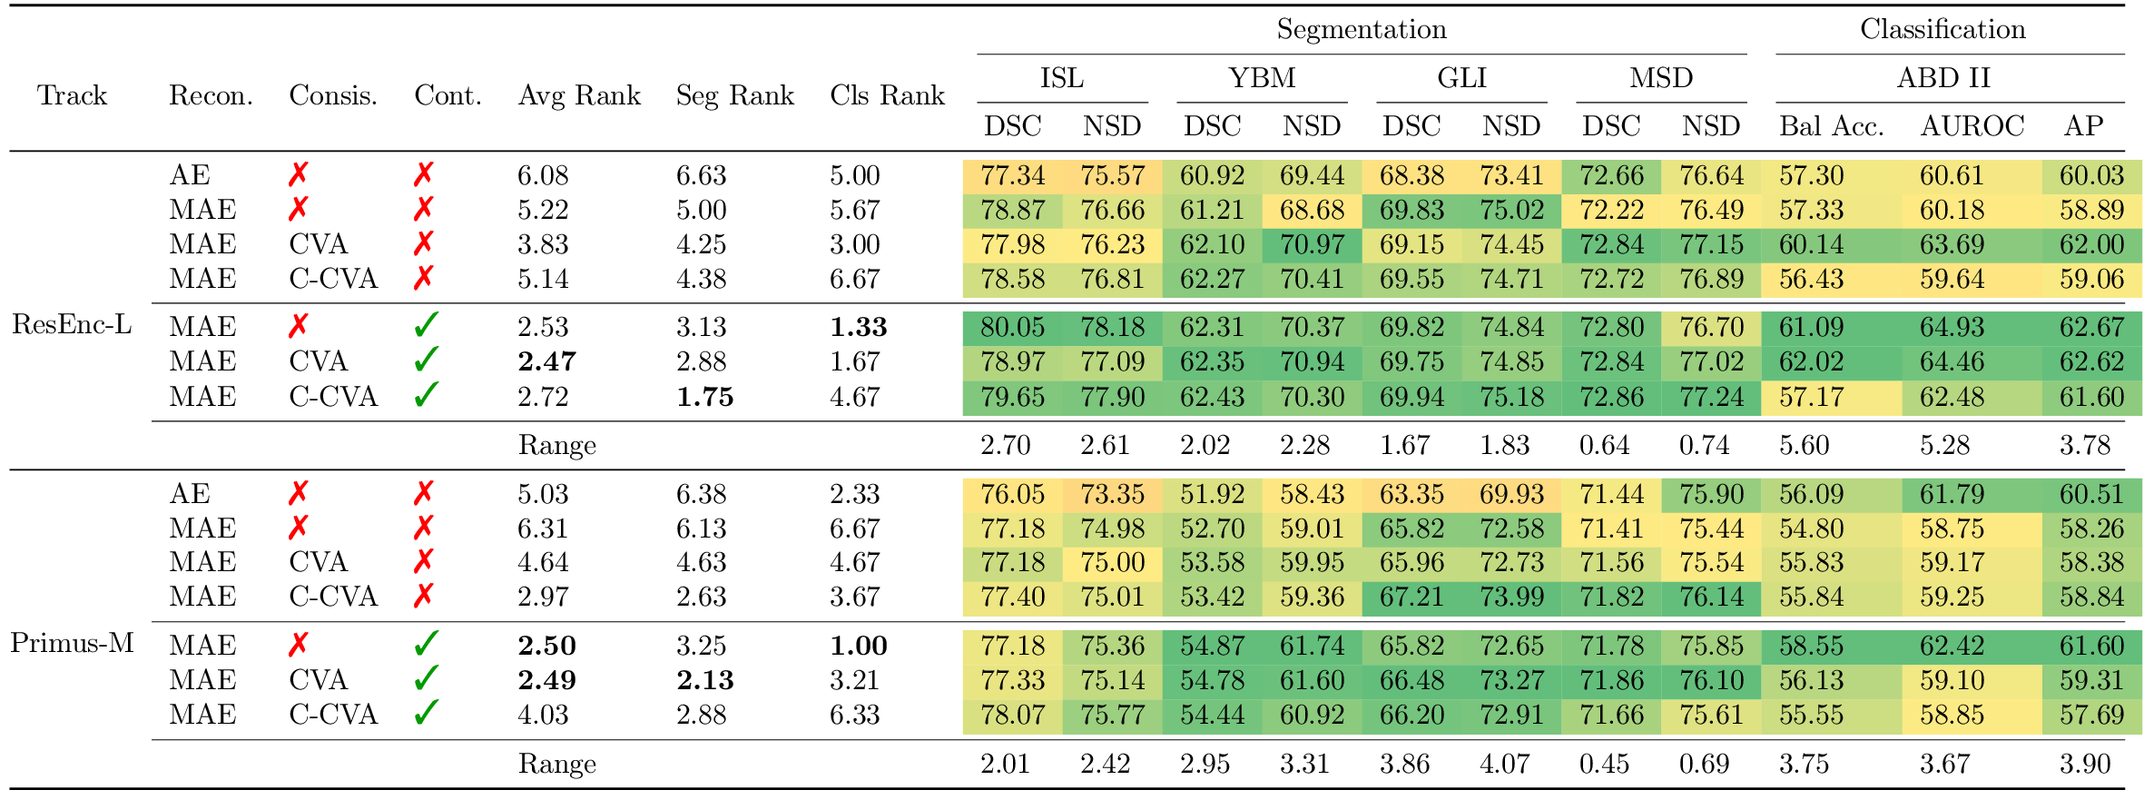
Quick Ablations

Slide 28
Ablations – Dynamic Range

